Slide 1
Doing Good Business with the
Good
Business
Charter

Slide 2
recognise, champion and encourage responsible business behaviour

Slide 3
The Good Business Charter sets out a clear benchmark for responsible business behaviour with minimum standards required. That makes it a high bar worth striving for (e.g. many don't pay the real living wage).
The 10 components cover care for employees, suppliers, customers and the planet as well as paying your fair share of tax.

Slide 4
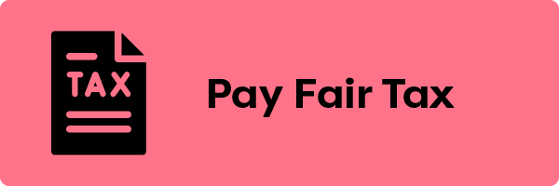

Slide 5
97% of consumers in a 2021 poll said they think it is important for a business to act responsibly (TSB Consumer poll, June 2021)
The most recent Institute of Business Ethics survey (2023) found that 43% of respondents felt that corporate tax avoidance was the most important ethical issue for them. This topped the list for the 11th year running.
Almost half of younger workers (46%) want the company they work for to demonstrate a commitment to ESG, and 20% have turned down a job offer when the company’s ESG commitments were not in line with their values. (KPMG, January 2023)

Slide 6
Accreditation demonstrates that you put people first...

Slide 7
...and that you exist for much more than profit.

Slide 8
The Good Business Charter framework helps you to communicate your values, attract top talent and foster loyal customers.

Slide 9
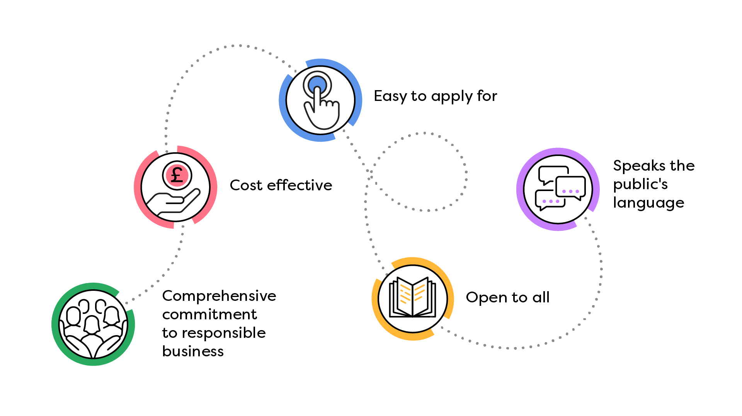

Slide 10
Customers, employees and other stakeholders want to work with companies who share their values and that they can trust – you can communicate them clearly and encourage those in your supply chain and your clients to accredit too.

Slide 11
It's an accessible and affordable way to let customers, employees and suppliers know that you are a great company to work with – and sets you apart because you can meet all 10 components.
Many can't – accredit and you can lead the way.

Slide 12
visit goodbusinesscharter.com
Join the movement for a fairer, sustainable world where people matter.

